Slide 1
Societies Assembly Wednesday 18th February
Please Sign in at the Desk to receive your voting card

Slide 2
Agenda
1 | Apologies for Absence
2 3 | Accepting the Agenda & Notification of A.o.B Approving Minutes of Previous Meeting
4 | Updates Elections Global Week
5 | Service Level Agreement
6 | Code of Practice
7 | VP Activity Report & Questions
8 | Any Other Business
9 | Date and Time of Next Meeting
Notes:
Go through 1-3 on this page.

Slide 3
Updates

Slide 4
a. Elections
Reminder of Key Dates:
Nominations open: Monday 2nd February - Friday 20th February @5pm.
AGM period: Saturday 21st February – Friday 13th March
Voting OPENS: Friday 13th March @ 5pm – Friday 20th March @5pm
Please note that we will not accept ANY nominations after the 20th
elections@su.ntu.ac.uk
societies@su.ntu.ac.uk
Notes:
Highlight that if we make an allowance for one society after the 20th February deadline, we have to do it for every society.
Reminds groups that members need to be registered to the website and tell them that the bug in the website has been fixed.

Slide 5

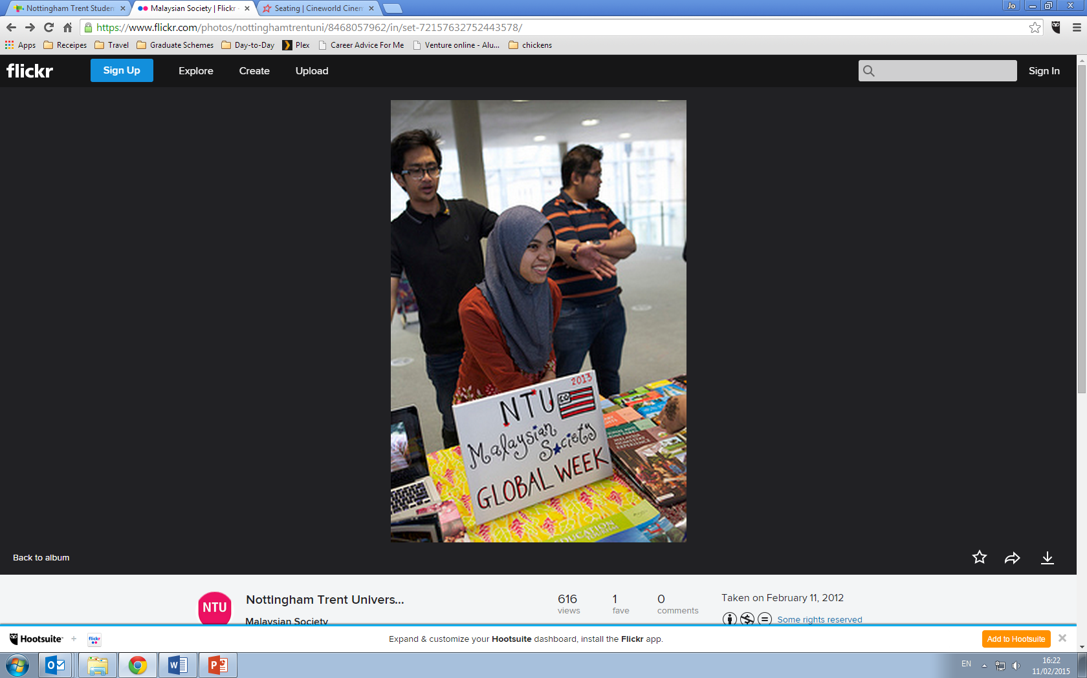
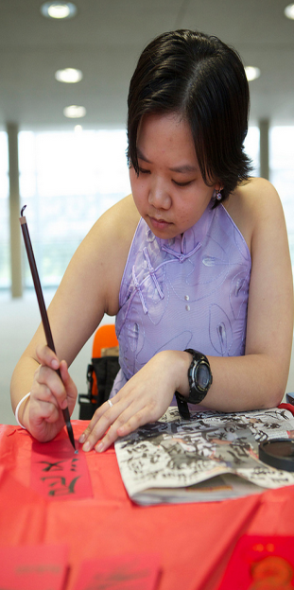
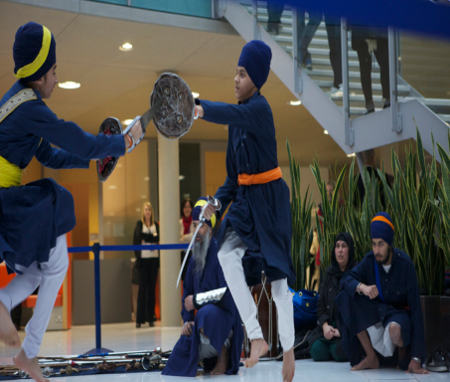
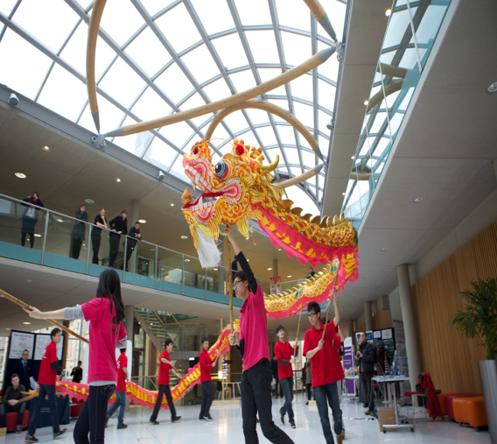
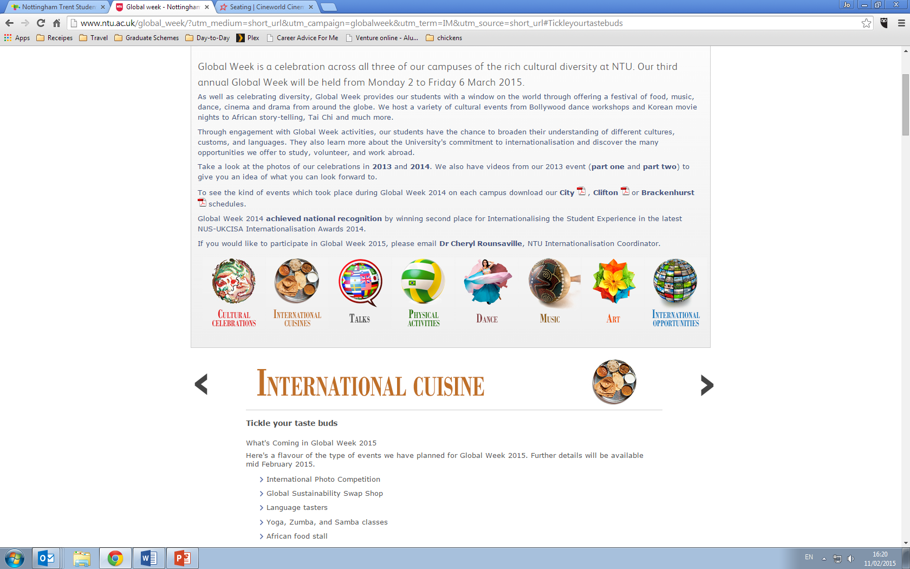
Funding available
Get involved!

Slide 6
5. Service Level Agreement
What Is It?
Agreement based on the Committee Facebook group which was set up for societies.
Ensures Facebook group is being used in an appropriate manner.
Responsibilities of NTSU
To approve/reject requests to join the group.
To provide a response to direct questions with 48 working hours.
To supplement information given out in emails.
To inform committee members if we are unavailable during busy periods and provide a contact for all urgent queries.
To monitor all content and to delete where appropriate.
Notes:
This was sent out last week. Available on the group too ☺

Slide 7
Responsibilities of Committee Members
To only invite committee members to the Facebook group.
To be respectful towards to all members
To use the group strictly for society matters.
To not promote any third party or external organisations.
Banned Behaviour
Offensive behaviour towards members (as defined by the NTU Student Code of Behaviour and NTSU Member Code of Conduct).
Permitting ticket sellers and promotion of non-affiliated nights.
Inappropriate content (swearing, aggressive behavior etc).
‘Spamming’

Slide 8
6. Code of Practice
As promised at the last Assembly, an updated Code of Practice has been produced.
Changes include:
More student friendly document that clearly outline procedures and protocol (i.e. Affiliations/Disaffiliations/suspensions/appeals)
Given more power to you – ratifying affiliation/disaffiliation but also voting on policies that affect societies directly
Development plans – clear development plans will be put in place for societies, those that fall under 15 members will now work with the VP Activities to rectify this in a devised time scale
Notes:
Really highlight that the old document had been revised many times and became ‘bloated’. It often contradicted itself and was far too long.. This is a trimmed down version that doesn’t actually ‘cut’ any content.

Slide 9
7. VP Activity Report & Questions
Societies
Revamped the Societies Code of Practice to reflect new legislation but also put more power in the hands of societies themselves.
Putting in place AGM training – This will take place Mon 23rd, Tues 24th and Thurs 26th Feb (Next week) Working with Elections to fix a bug that has been in the system Continue work on elections by helping with AGM’s Working on Handover packs to ensure committees have everything they need to pass on the baton
RAG
RAG Week took place last week – events were successful! Events such as Blind Date/Touch It saw lots of student engagement
Working with the committee to put in place events for 3rd term - smaller events across all three campuses
Currently planning an Easter themed event with Hall Reps

Slide 10
Any Other Business

Slide 11
Date & Time of Next Meeting
11th March 2015 - NEWLT4
3pm – 5pm

